Slide 1
HS2041 – Enterprise Systems
Final Individual Assessment

Slide 2
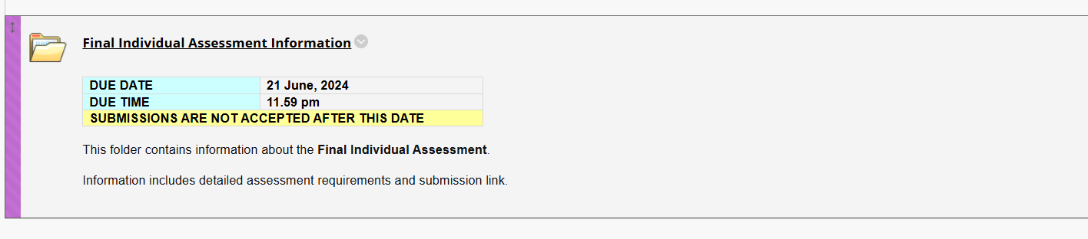
Due Date for Final Individual Assessment – HS2041

Slide 3
General Statement for Final Individual Assessment - HS2041: Enterprise Systems
To perform well in the final individual assessment for HS2041: Enterprise Systems, you need to understand and articulate several key topics related to enterprise systems, their components, implementation processes, and the associated benefits and risks. By mastering these areas, you can provide comprehensive answers and support your arguments with relevant examples and case studies. Here are the essential topics and steps to prepare:

Slide 4
General Statement for Final Individual Assessment - HS2041: Enterprise Systems
1. Understanding Enterprise Systems and ERP:
Define what enterprise systems are and explain the role of an ERP (Enterprise Resource Planning) system. Compare ERP with traditional Transaction Processing Systems (TPS), Management Information Systems (MIS), and other information systems.
Identify and describe the five key components of an ERP system and determine which component is most critical during implementation and why.

Slide 5
General Statement for Final Individual Assessment - HS2041: Enterprise Systems
2. Benefits and Value Creation of ERP Systems:
Discuss the benefits of using an ERP system in an organization. Provide examples of how ERP systems create value through improved efficiency, data integration, and decision-making support.
Explain how ERP systems support Web Intelligence capabilities and enhance business operations.

Slide 6
General Statement for Final Individual Assessment - HS2041: Enterprise Systems
3. Risks and Life Cycle of ERP Implementations:
Describe the three types of risks associated with ERP implementations, such as project management risks, operational risks, and technical risks.
Compare and contrast the ERP Life Cycle with the Systems Development Life Cycle (SDLC).
4. ERP Implementation Process and Costs:
Outline the steps involved in the implementation of an ERP system, from planning and selection to deployment and post-implementation support. Summarize the potential cost categories associated with ERP implementation.

Slide 7
General Statement for Final Individual Assessment - HS2041: Enterprise Systems
5. Ethical Theories and ERP Implementation:
Describe how normative theories of ethical behavior, including Stockholder Theory, Stakeholder Theory, and Social Contract Theory, influence ERP implementation decisions.
6. Evaluating ERP Trends and Vendors:
Analyze key ERP trends for 2024 as described in relevant articles and select the most significant and realistic trends for the future of ERP systems.
Compare and contrast different ERP vendors based on their background, business functional areas supported, and cost. Provide a justified recommendation for selecting an ERP vendor for a small manufacturing company.

Slide 8
General Statement for Final Individual Assessment - HS2041: Enterprise Systems
Step-by-Step Instructions to Achieve High Distinction
Start Early: Begin your preparation well in advance to ensure you have ample time to review the course materials, case studies, and relevant literature.
Read the Assignment Instructions Thoroughly: Carefully read the instructions provided in the assessment document. Note the format, submission guidelines, and academic integrity policies.
Understand the Questions: Carefully read each question and its sub-questions. Break down the questions to understand what is being asked and identify the key areas to address.

Slide 9
General Statement for Final Individual Assessment - HS2041: Enterprise Systems
4. Organize Your Notes and Resources: Organize your notes, textbooks, and other allowed materials for quick reference. Highlight key concepts and examples that are relevant to the questions.
5. Draft Your Answers: Start drafting your answers in the provided answer boxes in MS Word. Ensure that each answer is clear, concise, and directly addresses the question. Use subheadings and bullet points where appropriate to organize your responses.
6. Use Real-World Examples: Incorporate real-world examples and case studies to support your answers. This will demonstrate your ability to apply theoretical concepts to practical scenarios.

Slide 10
General Statement for Final Individual Assessment - HS2041: Enterprise Systems
7. Review and Edit: After completing your draft, review your answers for clarity, coherence, and completeness. Check for grammatical errors and ensure that all parts of the questions are addressed.
8. Seek Feedback: If possible, seek feedback from peers or mentors to gain different perspectives and improve your answers.
9. Prepare for the Exam Conditions: Familiarize yourself with the exam conditions, such as the reading time and duration. Practice answering questions within the given time frame to improve your time management skills.

Slide 11
General Statement for Final Individual Assessment - HS2041: Enterprise Systems
10. Submit Correctly: Ensure that your final document includes your student details and submission declaration. Follow the submission guidelines precisely to avoid any penalties.
By following these steps and preparing effectively, you will be well-equipped to handle the course assessments and complete your exam with confidence.
Good luck!
Farshid

